Slide 1
Thesis Advisory Committee Meeting October 28, 2019
Vincent Baker
Drexel University Department of Physics

Slide 2
Thesis Plan
Matriculated Fall 2014, passed written exam Fall 2015, passed oral exam June 2018
Goal is to defend Fall 2020, reality may be Spring 2021
Summer 17-18
Fall 18-19
Winter 18-19
Spring 18-19
Summer 18-19
Fall 19-20
Winter 19-20
Spring 19-20
Summer 19-20
Fall 20-21
Oral exam
TAC meeting
TAC meeting
Thesis defense
Paper #1: Dynamics of traveling waves in a column
Write thesis
Paper #2: Machine learning using ensembles of columns

Slide 3
Research overview
Research question: What are the dynamics of traveling waves in “1-D” neural structures and what are their possible cognitive functions?
Research approach:
Simulate 1-D neural structures and study how topology, connectivity, neuron/synapse dynamics determine the formation and properties of traveling waves (complete)
Examine connected ensembles of 1-D structures (partially complete)
Place these simulated neural structures in a framework (to be done)

Slide 4
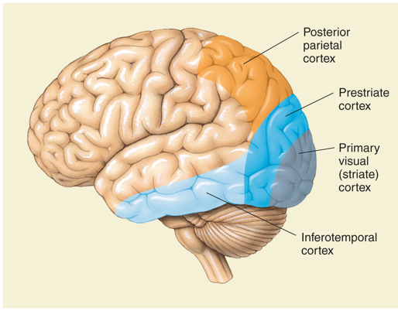
Impact
Traveling waves have been recently been observed in the cortex
One explanation for how the order of cognition evolves from the chaos of individual neuron activity
Various models for wave behavior including local connectivity, sequential time delay and coupled oscillators
Some general principles for computational role of traveling waves
What’s our novel contribution?
Exploration of traveling wave dynamics in 1-D neural structures (previous work in 2-D “sheets”)
Examination of traveling wave computational role using the Liquid State Machine artificial intelligence framework
Human visual cortex areas
1 mm
Cortical activation under advanced imaging, 9.6 ms/frame [6]

Slide 5
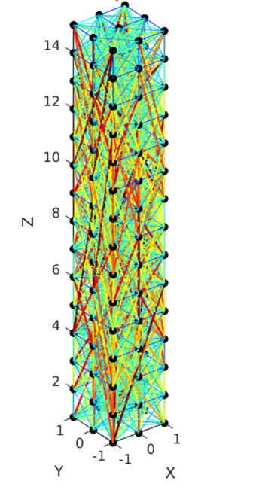
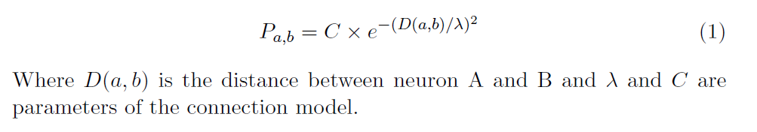
Column Topology and Connectivity
Topology: cross section (length x width), height
Most work done with 2x2x100 dimension columns
Connectivity: Long vs. short range, connection density
Connection probability:
Typically C=1, lambda=2.5 in our experiments
An example column of dimension 3x3x15. Neuron connections are color-coded according to their length. The neuron connectivity is mostly local, with some long-range connections.

Slide 6
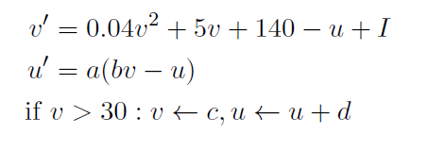
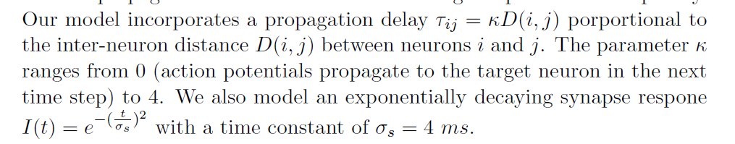
Column Dynamics
Neuron dynamics (Izhikevich model [3])
Neurons use a dynamics model with two dimensions
Connection dynamics
When a neuron fires, signal to connected neuron delayed and smoothed
v – neuron membrane voltage
u – recovery parameter
I – injected current, includes signals from other neurons and stimulus
a,b,c,d are model parameters
Neuron fires
Signal
Stimulus to connected neuron delivered with delay and smoothing
Time

Slide 7
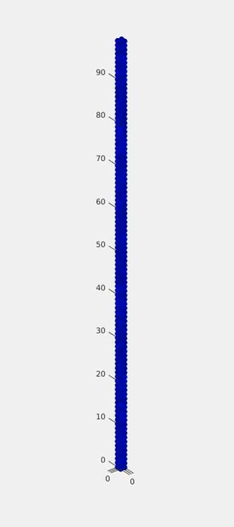

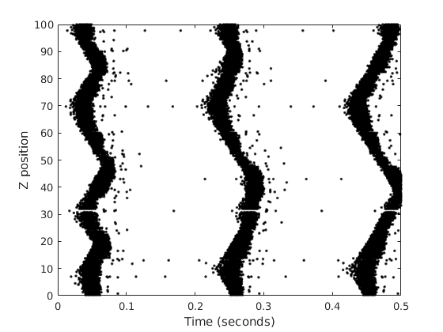
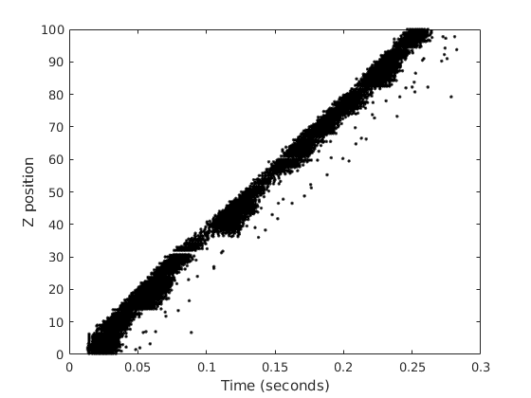
Traveling waves in columns
Uniform random stimulus to all neurons
Step stimulus to bottom 5 layers

Slide 8
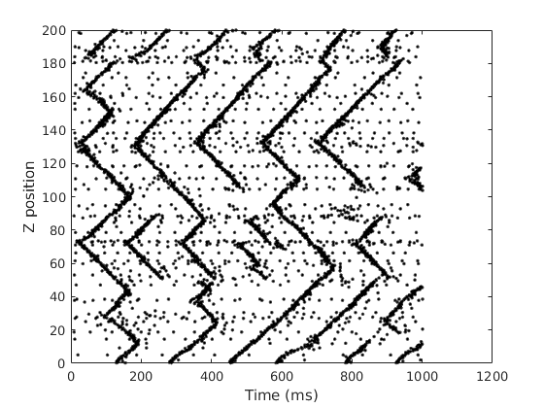
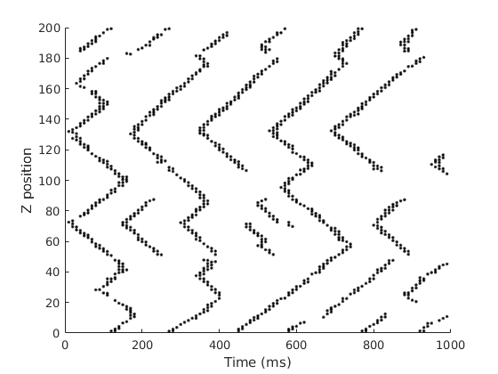
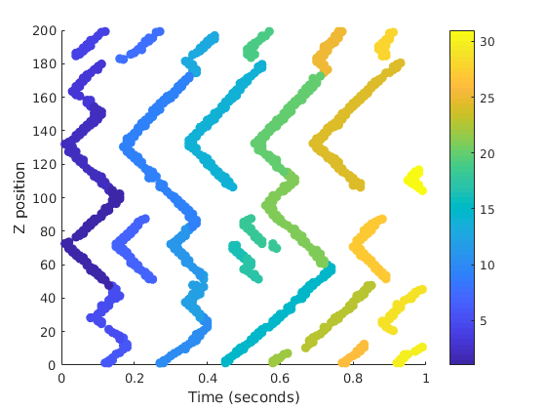
Wave detection and labeling
Need to determine wave properties, requires detection and labeling
Method: apply a density filter to remove background firing events, then use a plane sweep algorithm to label the waves
Raw firing events
Density filter
Labeled waves

Slide 9
Wave initiation
We observe that a given column has preferential sites for wave initiation
We also observe that a single propagating wave has a “density” that varies along the column
These two features are typically anti-correlated. Over 100 simulations, mean correlation coefficient was -0.28 with a standard deviation of 0.20.

Slide 10
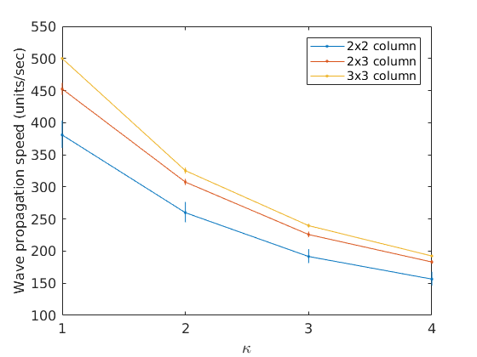
Wave velocity
The wave speed depends on the signal propagation delay parameter κ, but it’s not linear
Thicker columns support faster waves

Slide 11
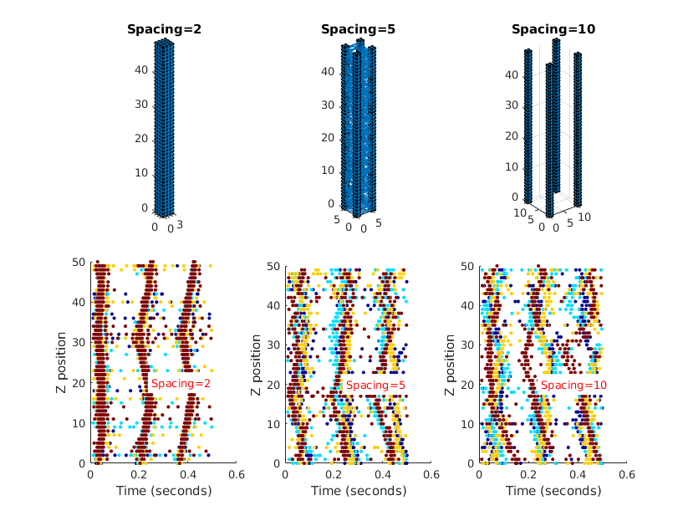
Ensembles of columns
Explore multiple 1-D structures with different levels of connectivity
With high connectivity, ensemble responds like a single large column
With no connectivity columns are independent
Weak connectivity: coupling between columns creates interesting dynamics

Slide 12
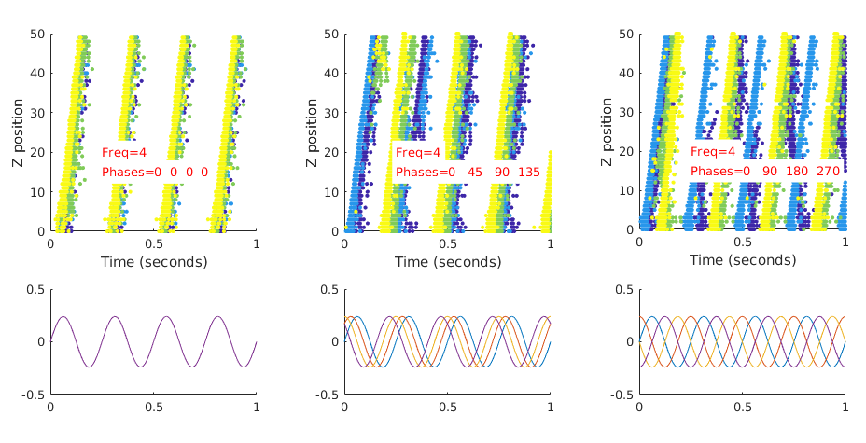
Ensemble w/ periodic stimulus
Ensemble with spacing =5
Changed the phase of the stimulus to each column
Ensemble tends to aggregate response if stimulus is close to in-phase, complex response when stimulus is out of phase
Firing diagram, color-coded by column
Stimulus, colord-coded by column

Slide 13
Summary
Progress to date:
Developed optimized simulation of neural column structures
Characterized traveling waves in single columns and ensembles of columns
Draft paper on traveling wave dynamics
Next steps:
Characterize column ensembles more thoroughly
Train a classifier based on ensemble of columns, measure classification performance as a function of column parameters (paper #2)
Develop thesis from papers 1 and 2

Slide 14
References
[1] S. V. Buldyren et al. “Description of microcolumnar ensembles in association cortex and their disruption in Alzheimer and Lewy body dementias".
In: Proceedings of the National Academy of Sciences, 97.10 (2000).
[2] Izhikevich MATLAB simulation. url: https://www.izhikevich.org/publications/net.m.
[3] E. Izhikevich. “Simple Model of Spiking Neuron". In: IEEE Transactions on Neural Networks 14 (2003).
[4] Eugene Izhikevich. Dynamical Systems in Neuroscience. MIT Press, 2007.
[5] Adam Keane and Pulin Gong. “Propagating Waves Can Explain Irregular Neural Dynamics". In: Journal of Neuroscience 35.4 (2015).
[6] Doron Shoham et al, "Imaging Cortical Dynamics at High Spatial and Temporal Resolution with Novel Blue Voltage Sensitive Dyes", Neuron vol 24 1999
[7] Wolfgang Maas and Henry Markram. “Real-time Computing Without Stable States: A New Framework for Neural Computation Based on Perturbations“, Neural Computation 14 (2002).
[8] Henry Markram, Yun Wang, and Misha Tsodyks. “Differential signaling via the same axon of neocortical pyramidal neurons“, Proceedings of the National Academy of Sciences, 95 (1998).
[9] The p-delta rule for parallel perceptrons. url: http://www.igi.TUGraz.at/maass/p%20delta%20learning.pdf.
[10] Y. Zhang et al. “A Digital Liquid State Machine With Biologically Inspired Learning and Its Application to Speech Recognition".
In: IEEE Transactions on Neural Networks and Learning Systems 26.11 (2015).

